Slide 1
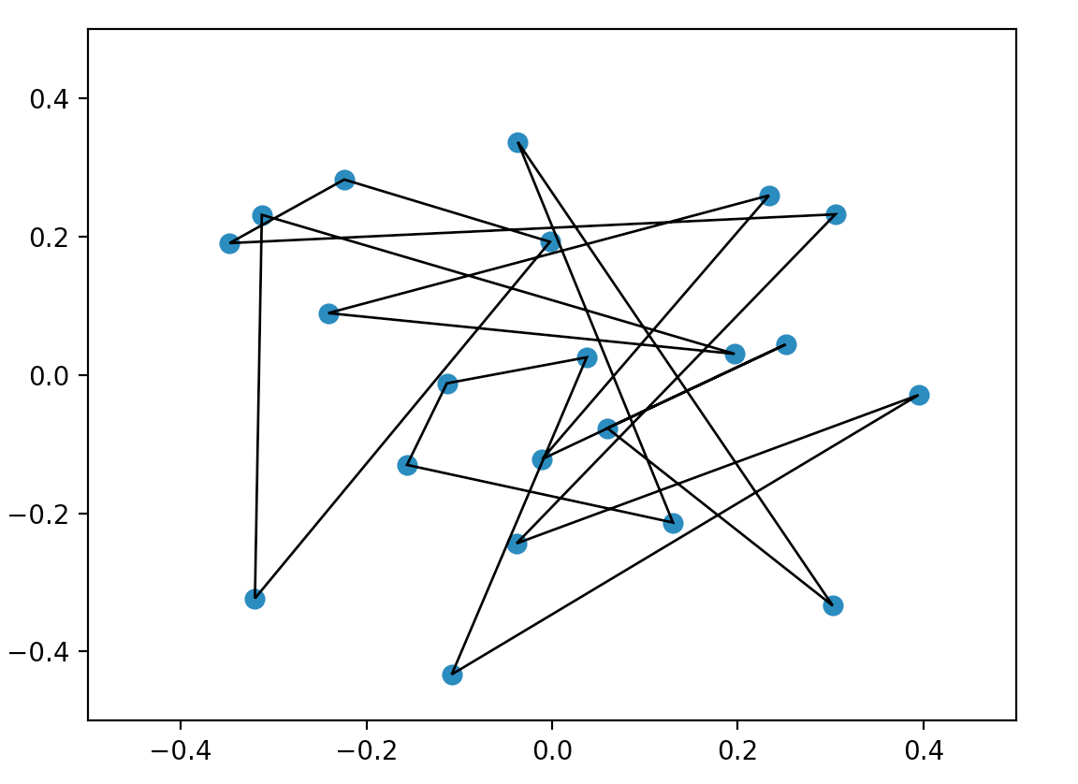
DM561 – Linear Algebra with Applications Week 48, 2021 From Random Polygon to Ellipse
Daniel Merkle
daniel@imada.sdu.dk

Slide 2


The 2018 winner: Charles Francis Van Loan
The topic of this lecture is based on his speech when receiving the award (Sept 2018).

Slide 3
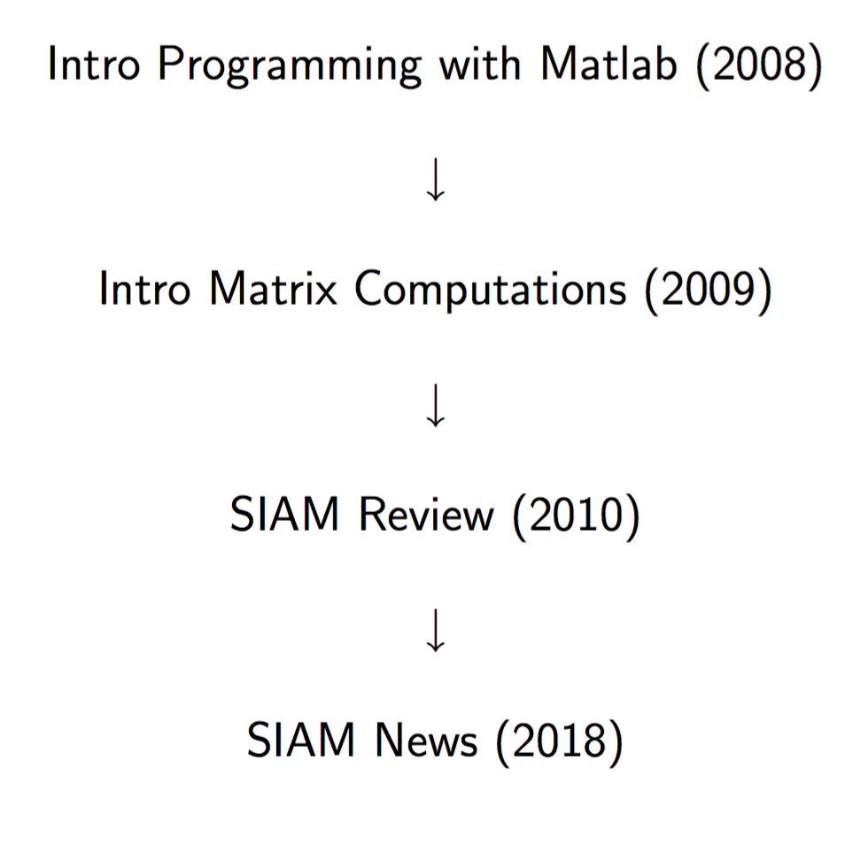
DM561 – Linear Algebra with Applications
Based on: A.N. Elmachtoub, C.F. Van Loan (2010), From random polygon to ellipse: an eigenanalysis, SIAM Rev. 52, 151–170.
John von Neumann prize lecture, Sept 2018, for C.F. van Loan

Slide 4
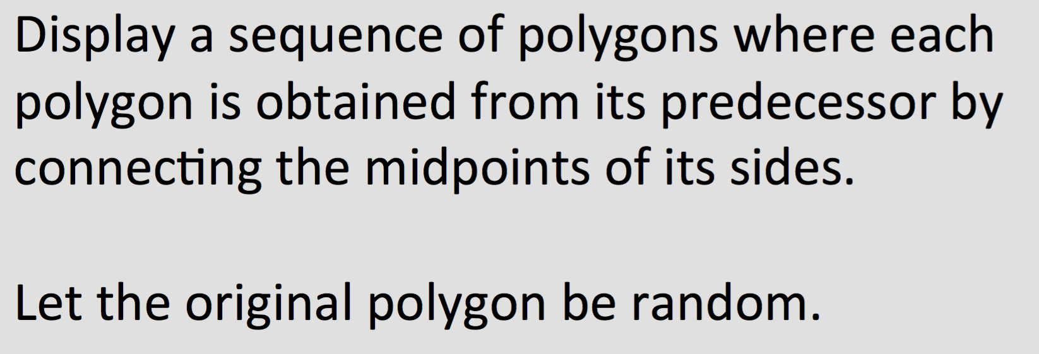

Slide 5
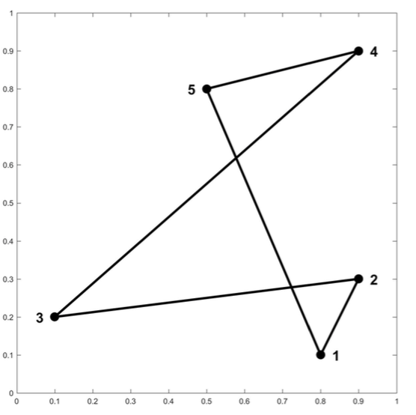
A random polygon (5 points)

Slide 6
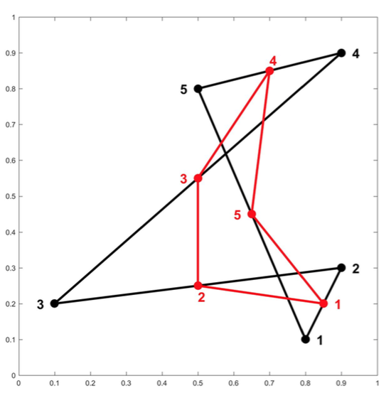
Connecting the midpoints

Slide 7
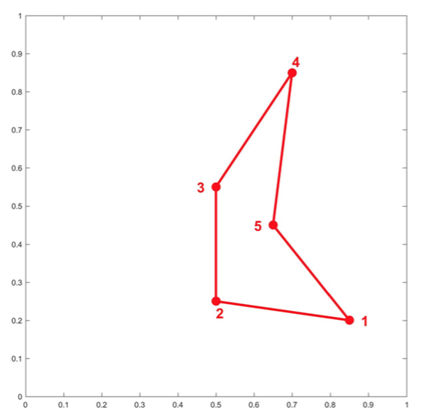
New polygon

Slide 8
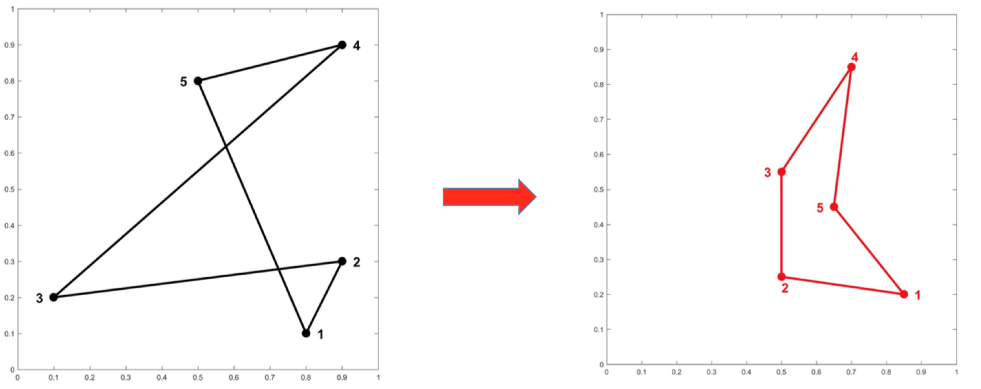
One step. This obviously can be repeated.

Slide 9
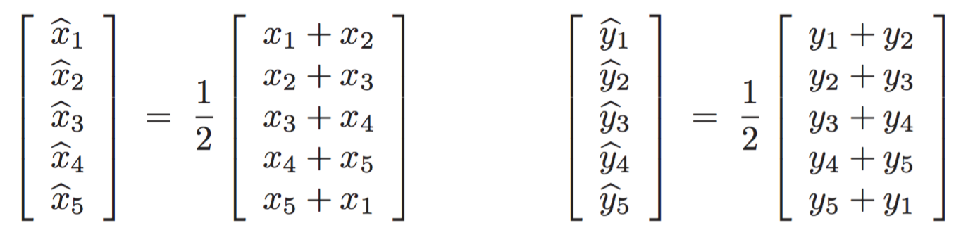
One Step in Vector Terminology
Assume the following five points define a close polygon:

Slide 10
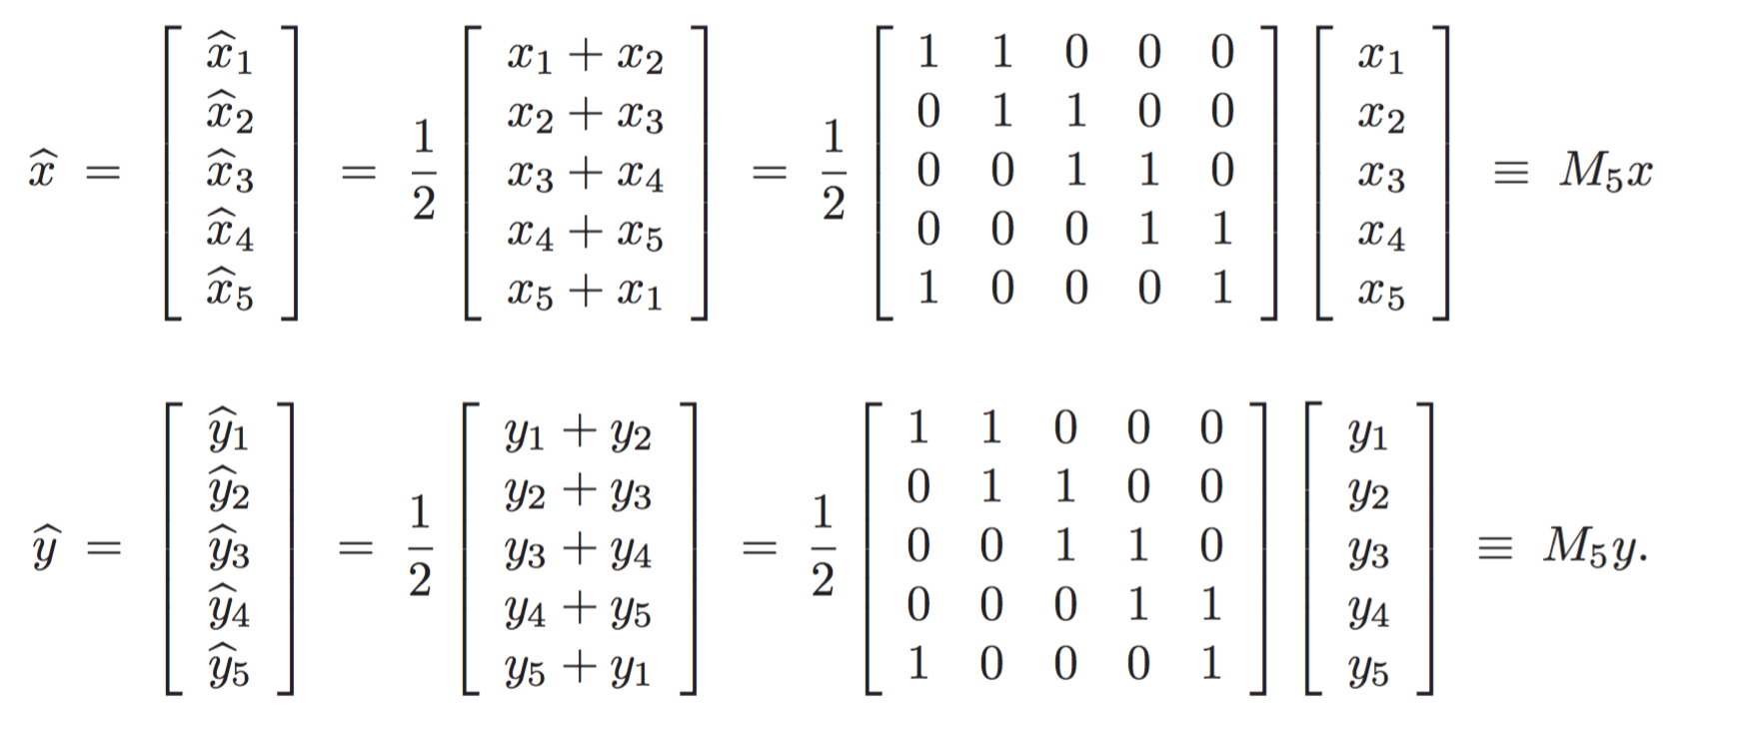
One Step in Matrix Terminology

Slide 11
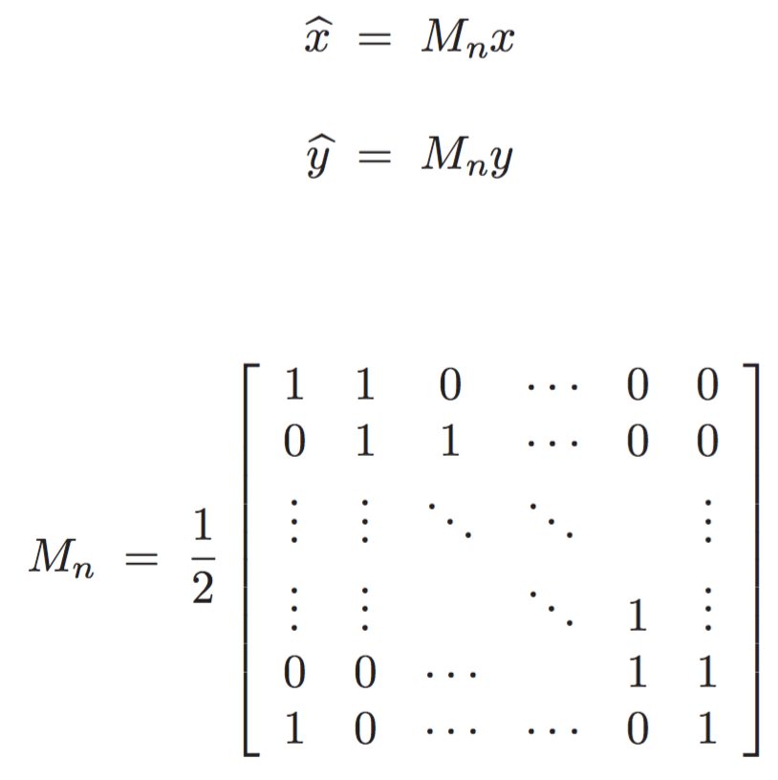
In general

Slide 12
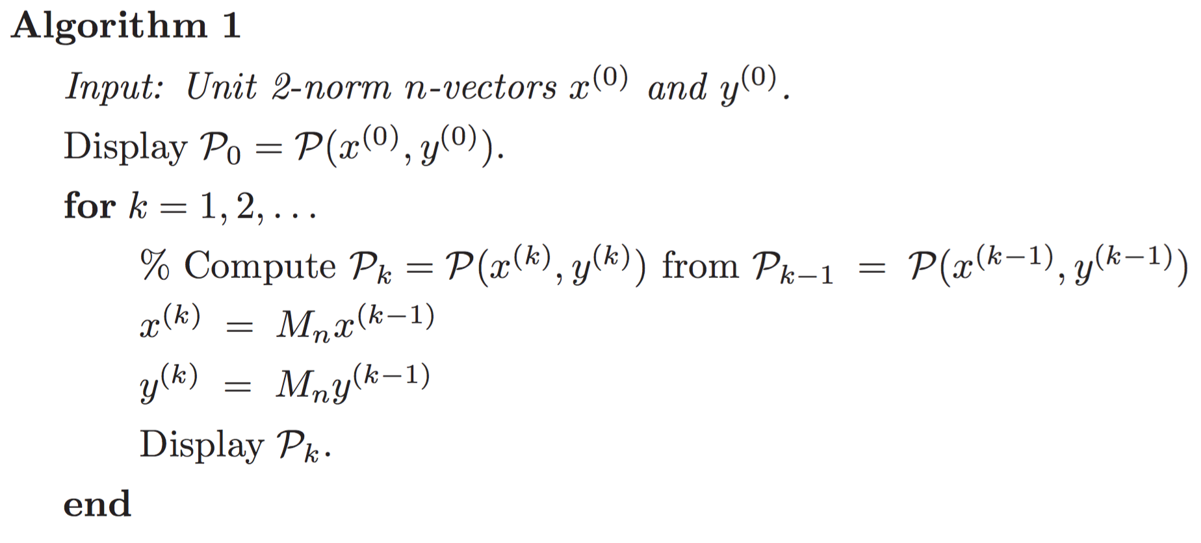
A First Try
length = 1, i.e.,

Slide 13
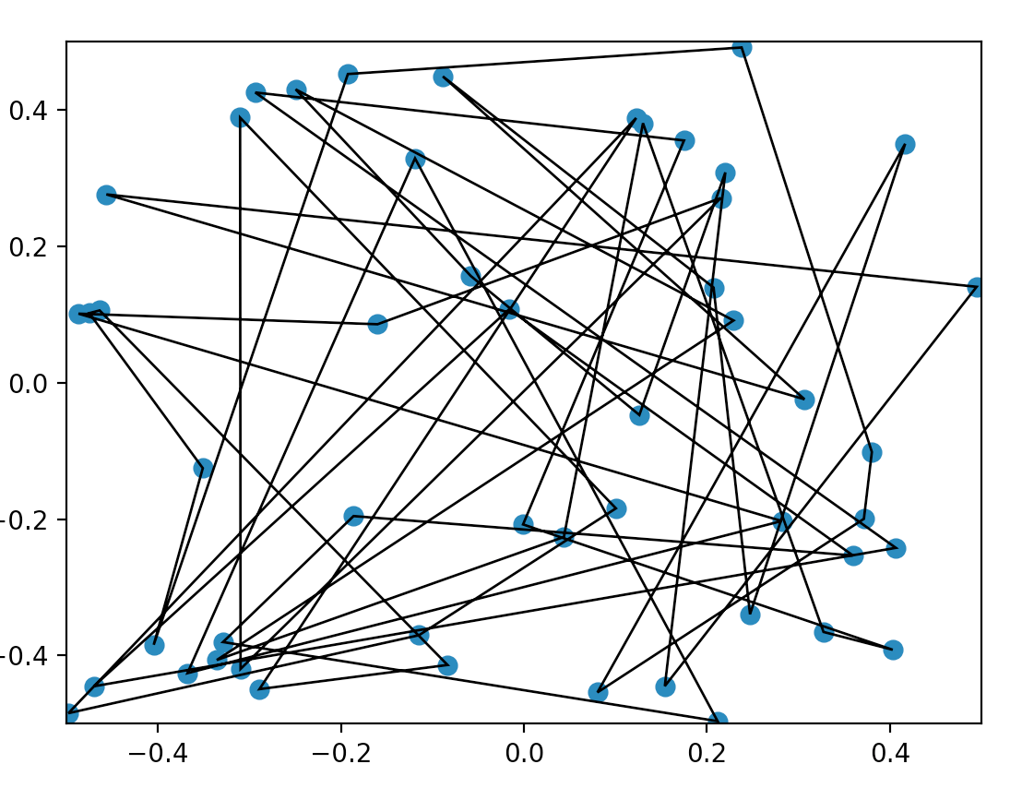
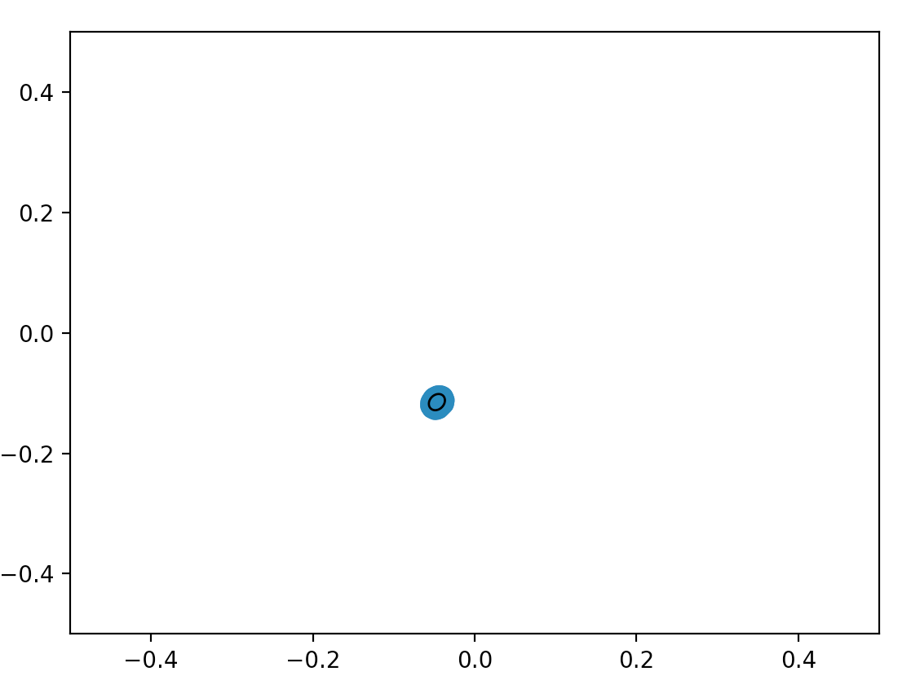
Not too interesting …
The points seem to converge to a point. Not too surprisingly, it’s the centroid of the input points.

Slide 14
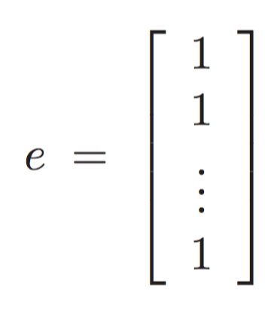
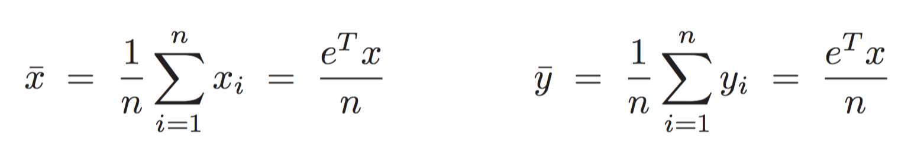
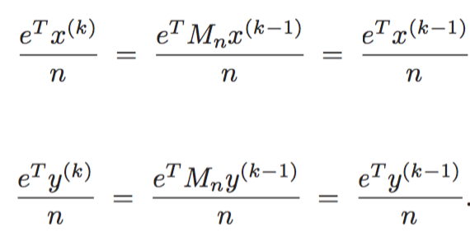
Centroid remains unchanged
Centroid:
As it holds:

Slide 15
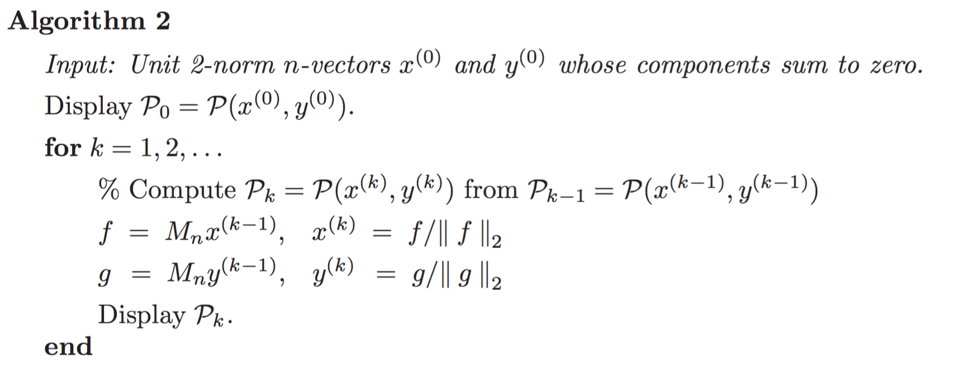
A Second Try

Slide 16
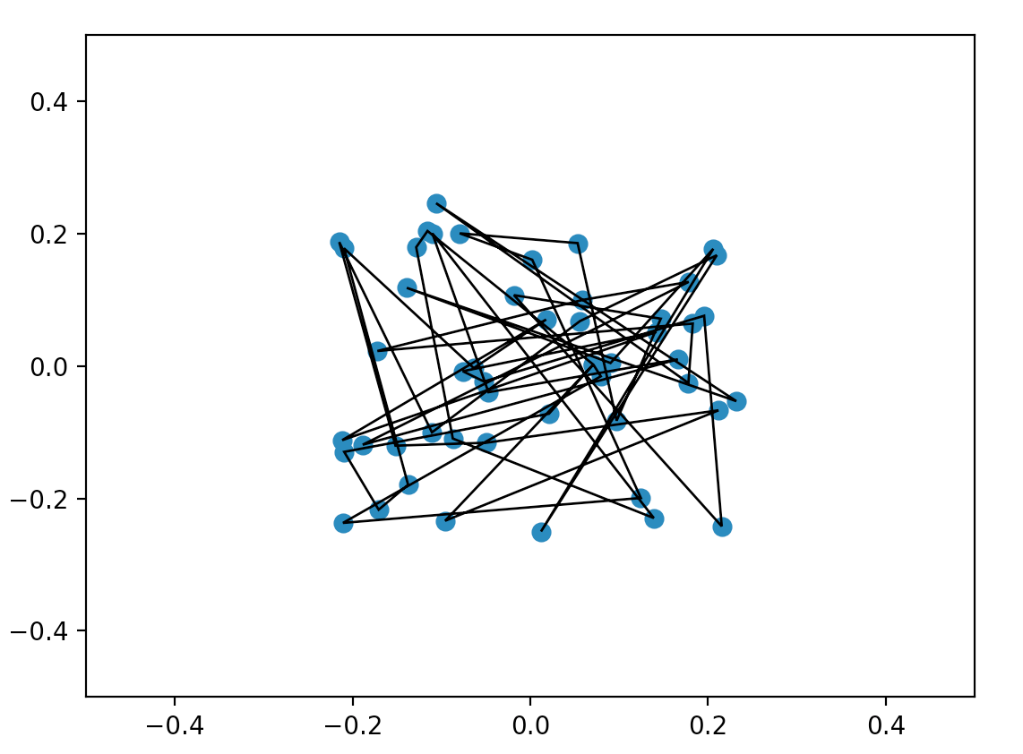
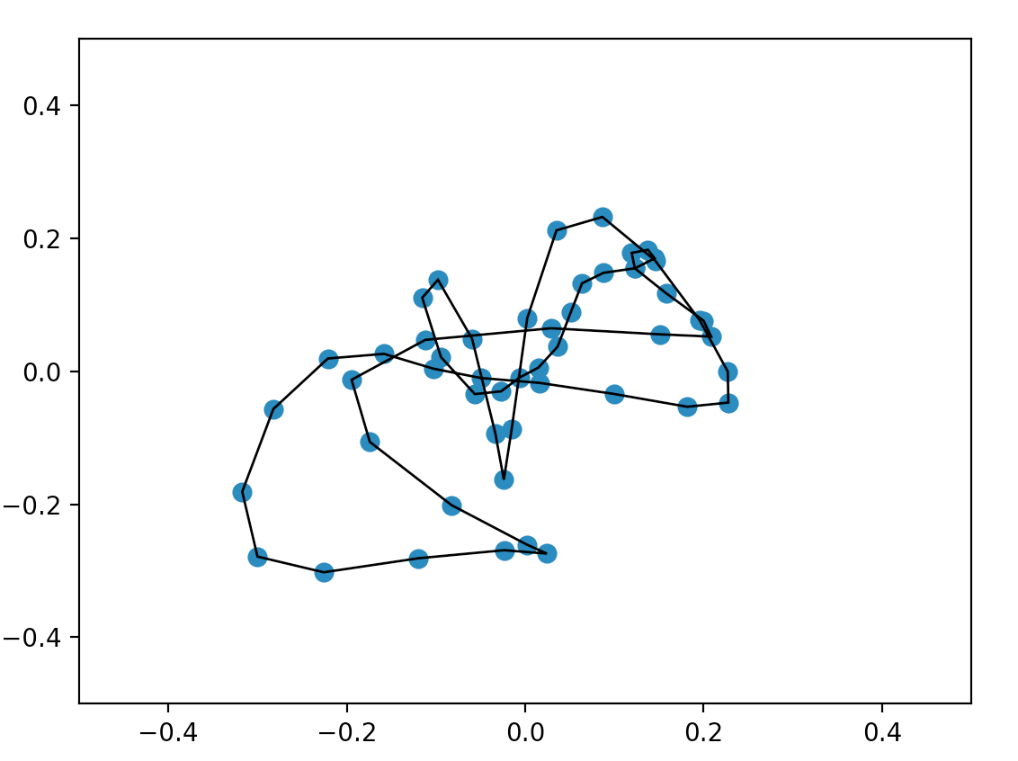
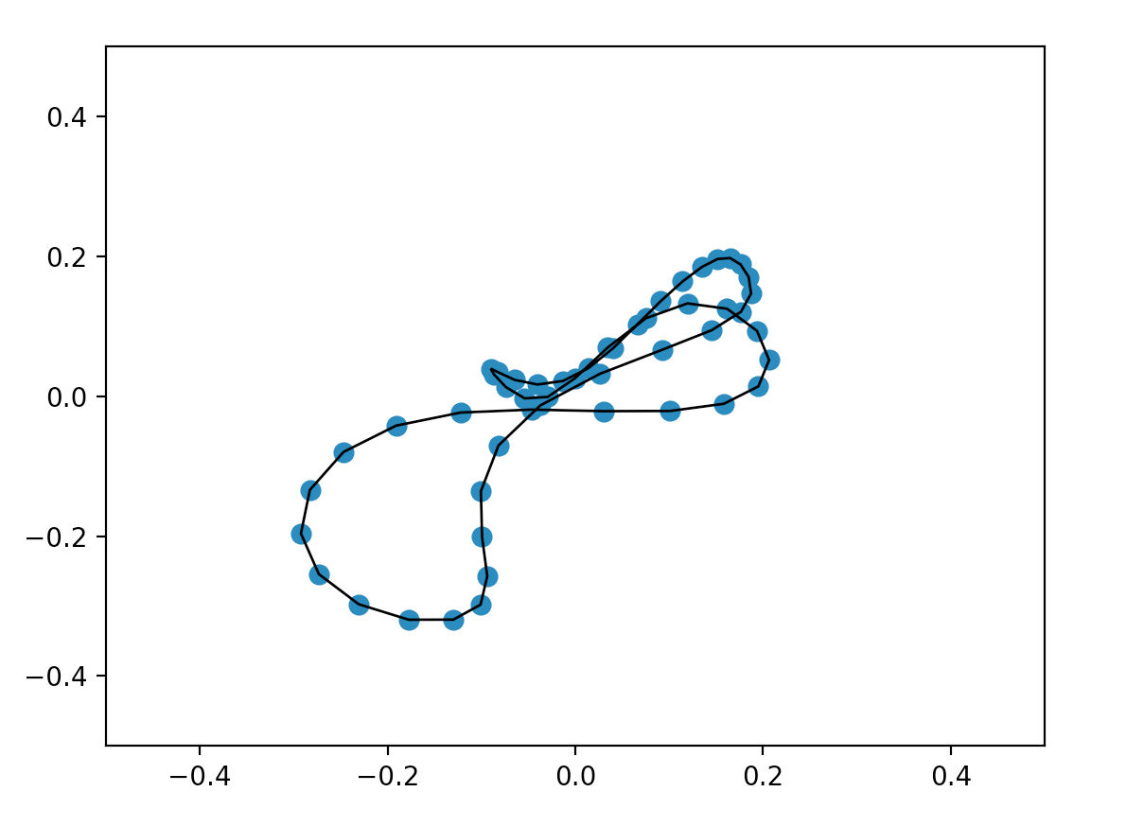
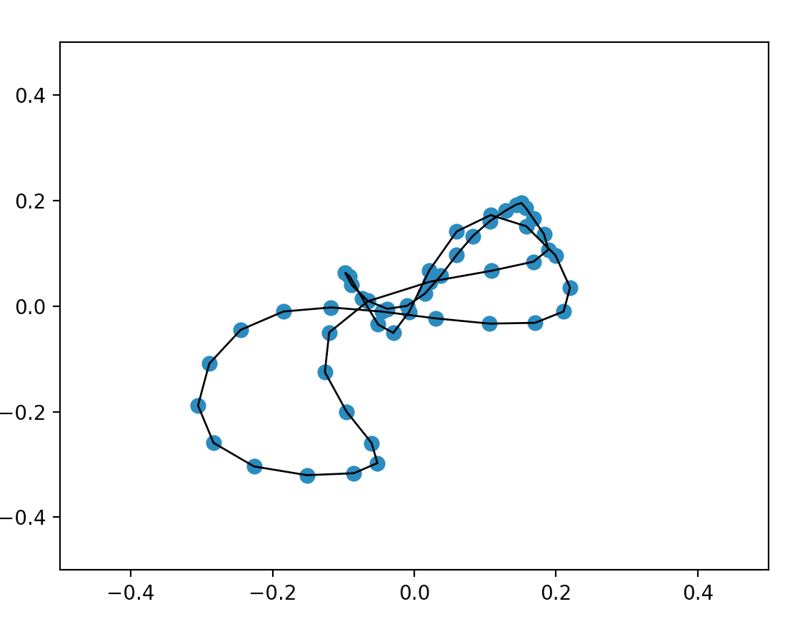
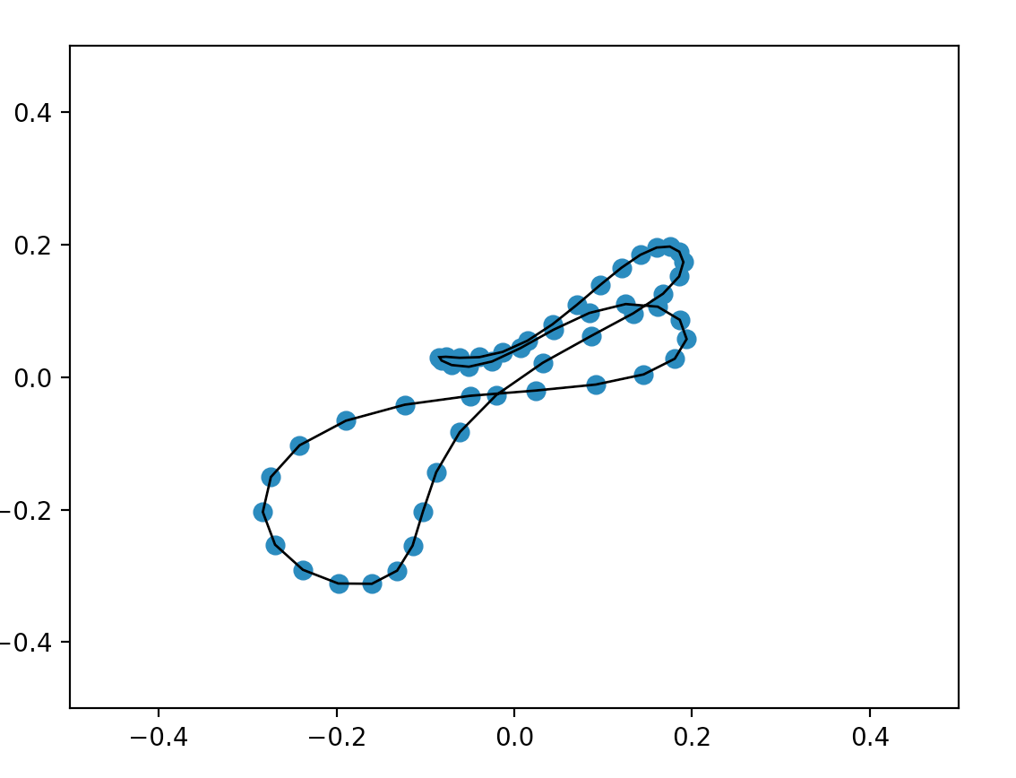
What’s happening???

Slide 17
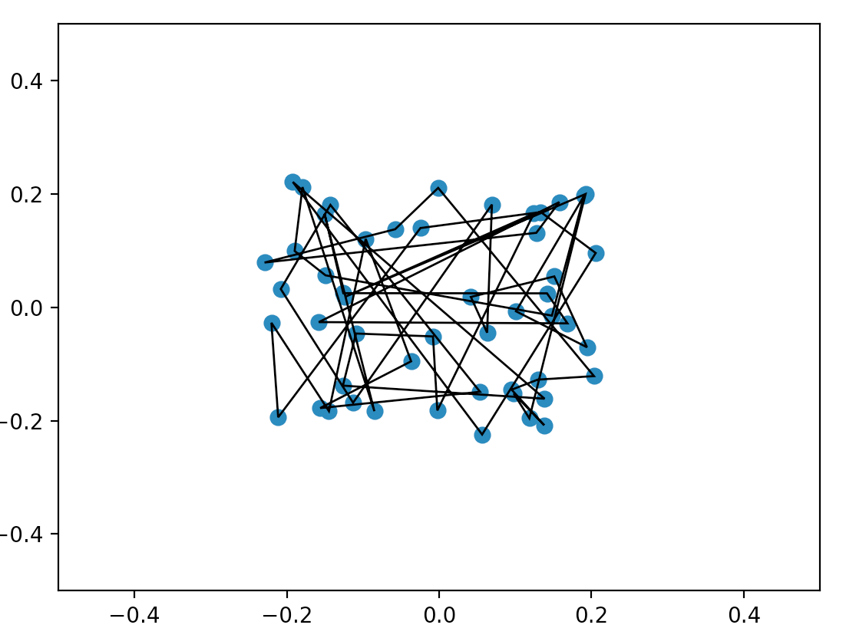
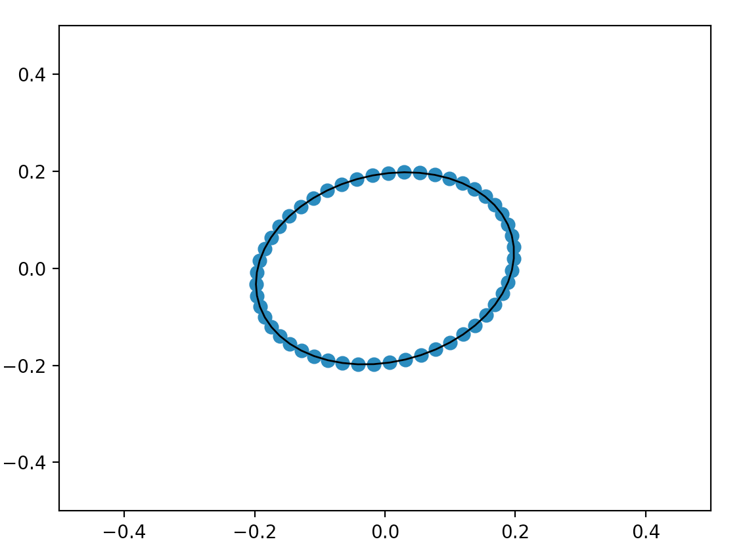
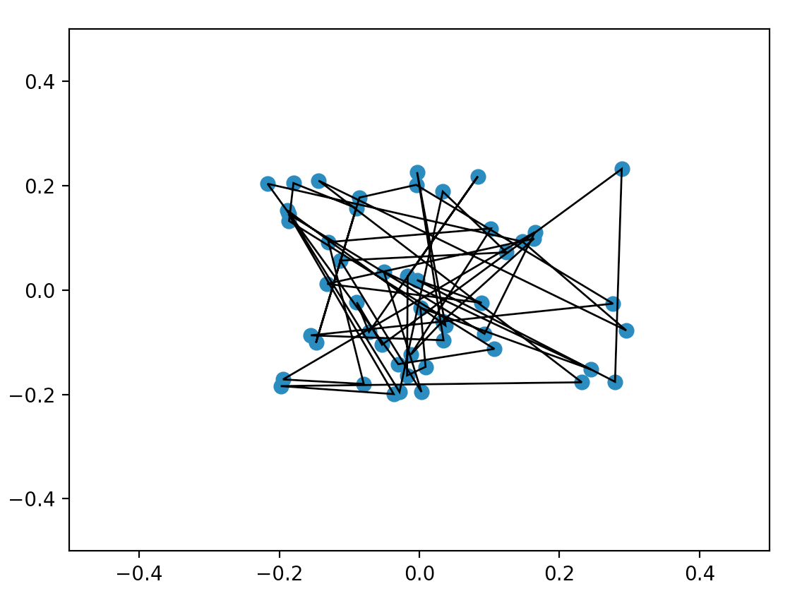
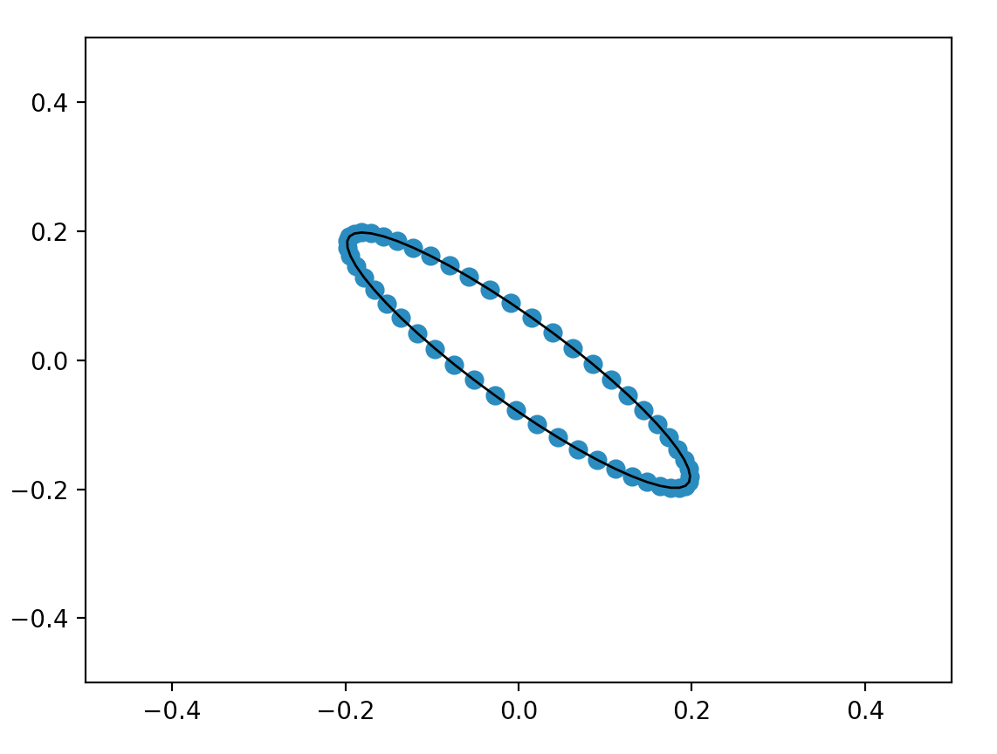
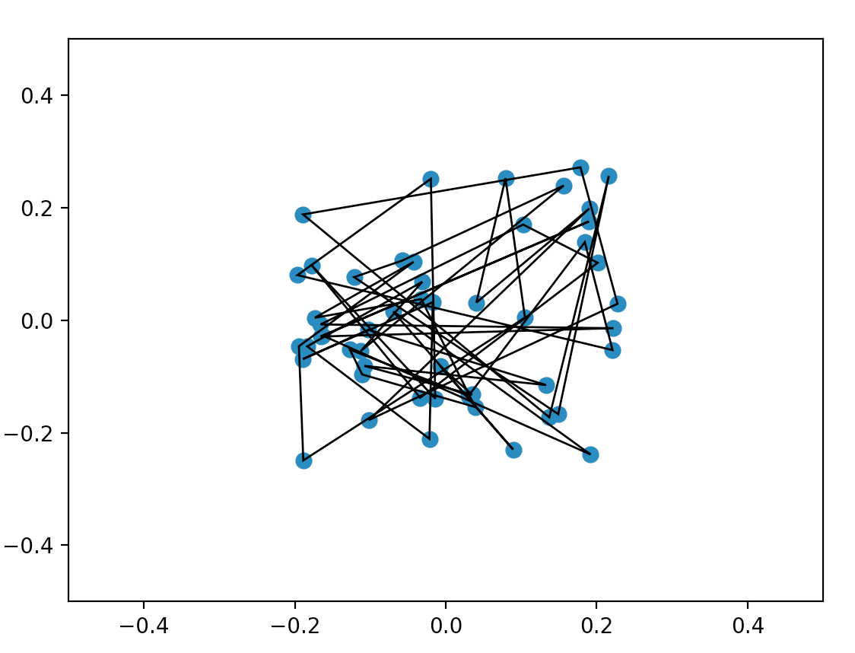
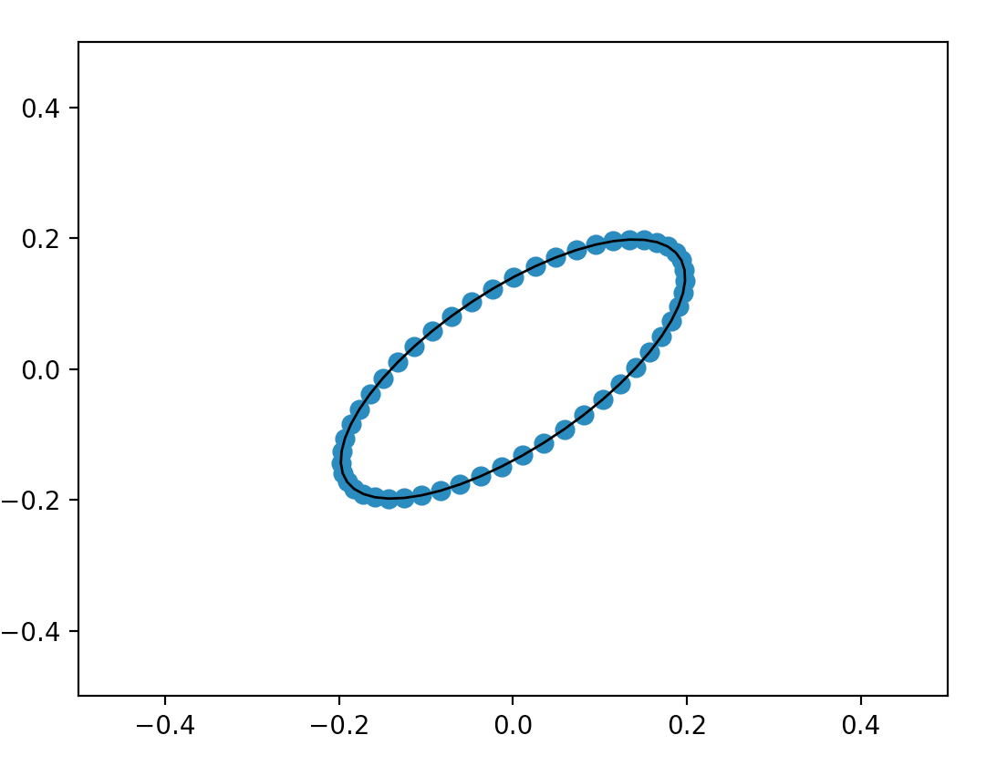
Three test runs

Slide 18
The points seem to converge to an ellipse with a 45-degree tilt
What is the limiting ellipse and why the 45-degree tilt?
How long does it take to “converge”?
Does it always converge?
What is the inverse of the repeated polygon averaging process, and does it always exits?
Experimental Mathematics

Slide 19
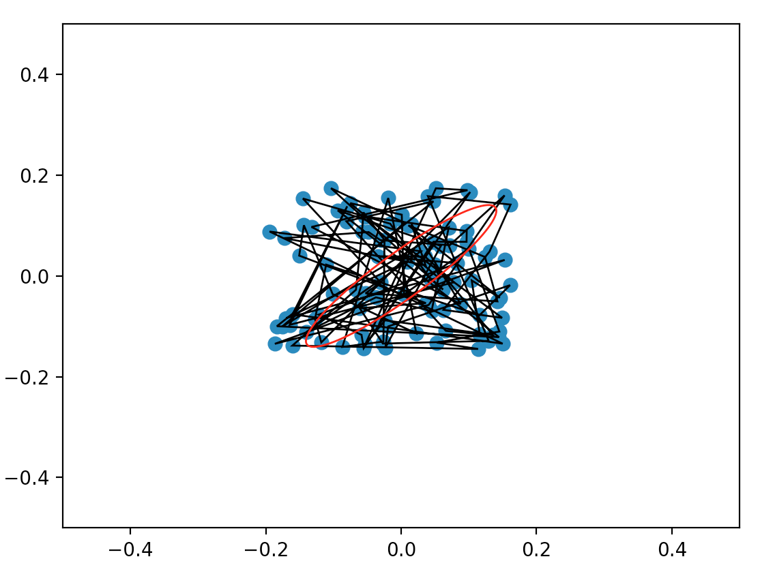
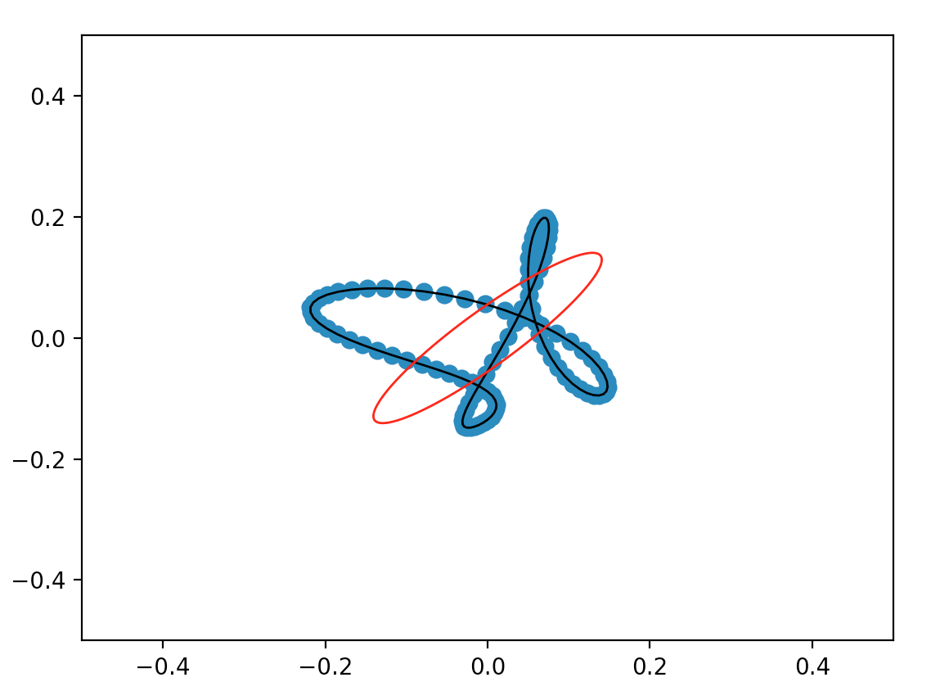
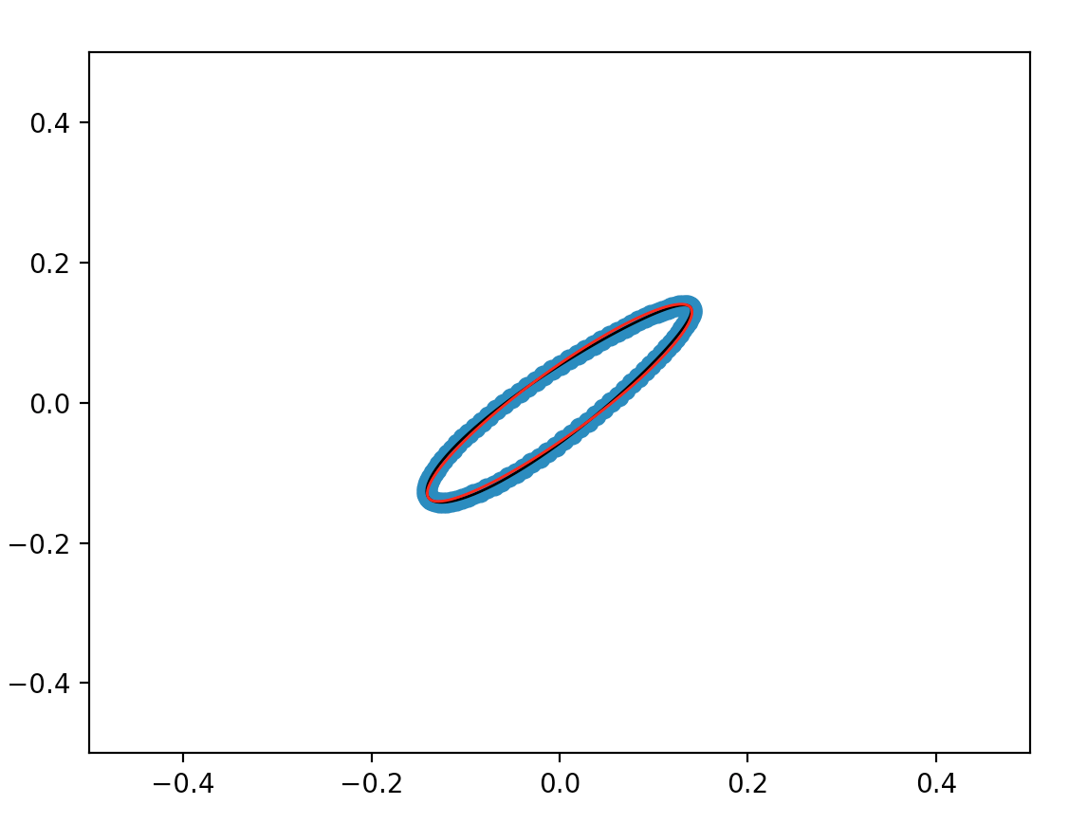
The ellipse can be computed in advance
Example: Polygon with 101 points
Step 1 Step 100 Step 500

Slide 20
Pre-Computation of the ellipse
Background: The analysis is not trivial, and requires
an understanding of the eigen-system of the matrix M
decomposition techniques (SVD- and Schur- decomposition)
Interested?
Follow the wonderful von Neumann Price Lecture from Charles F. Van Loan
Read the (not so easy parts of the) paper “From Random Polygon to Ellipse: An Eigenanalysis”, Adam N. Elmachtoub and Charles F. van Loan

Slide 21
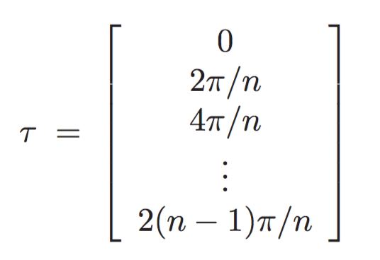
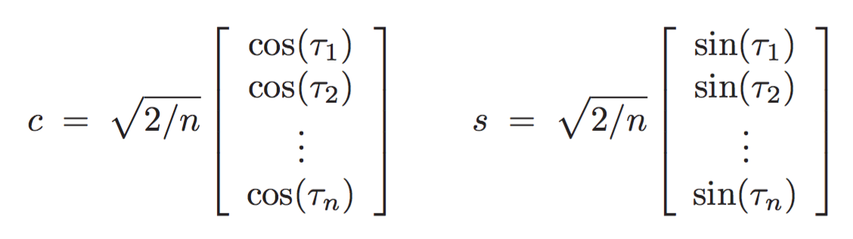
Pre-Computation of the ellipse
For a polygon with n points, define vectors c and s as follows (they form a orthonormal basis)

Slide 22
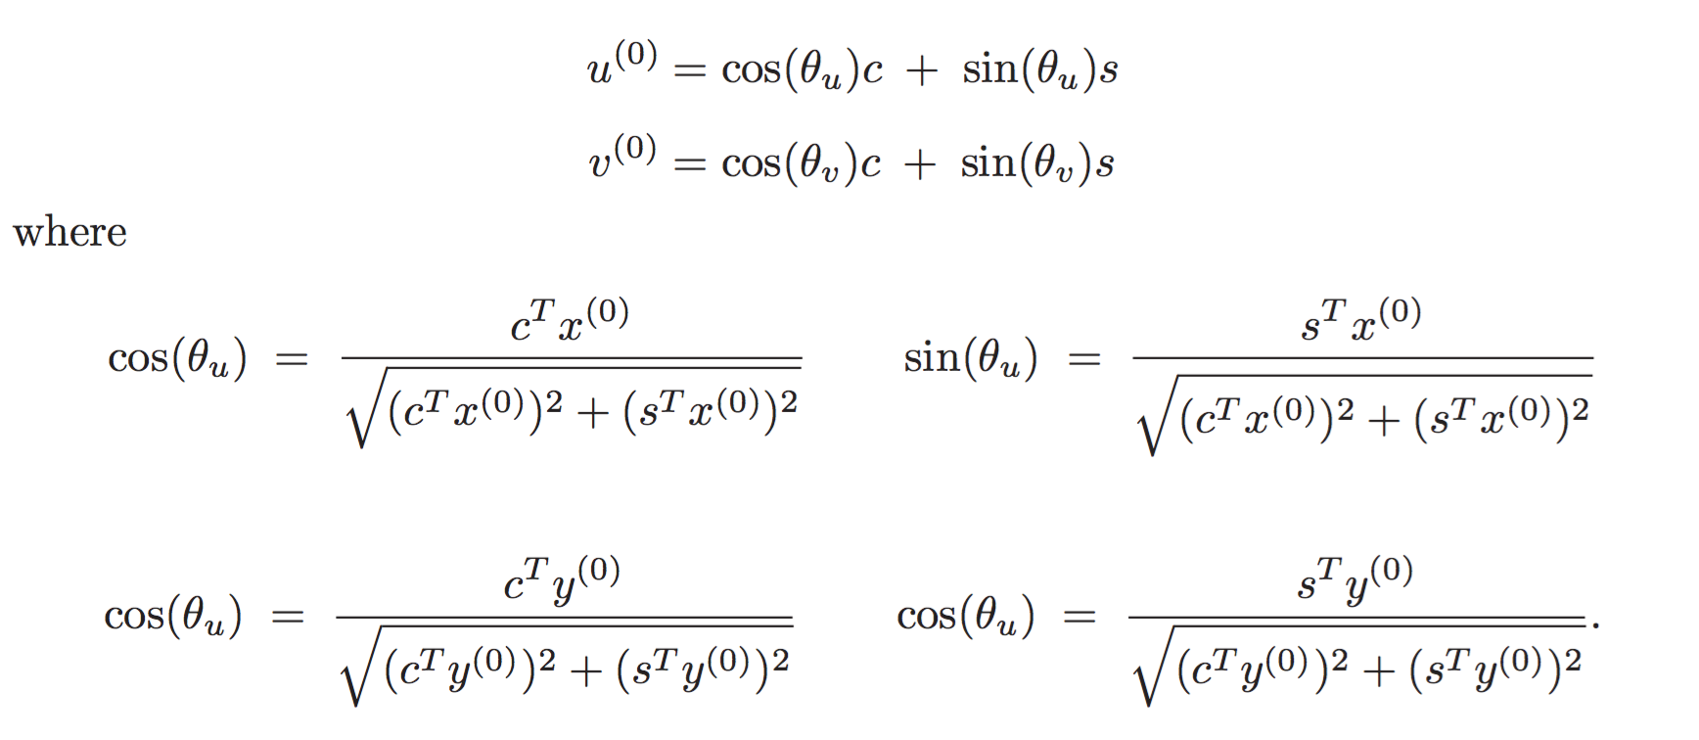
Pre-Computation of the “ellipse”
The polygon converges (at even even steps) to the closed polygon defined by vector u⁽⁰⁾ and v⁽⁰⁾
Proof: paper! (Note, TYPO in paper)

Slide 23
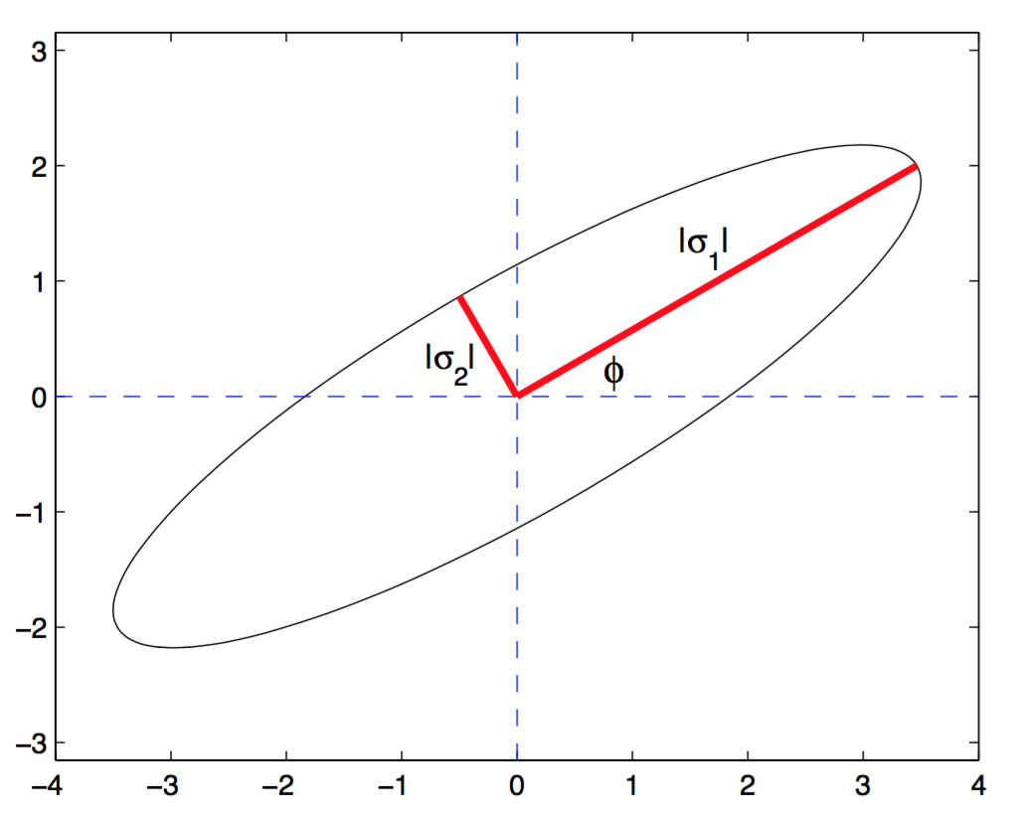
Pre-Computation of the ellipse
Also in the paper: An understanding of the shape of the ellipse in terms of :

Slide 24
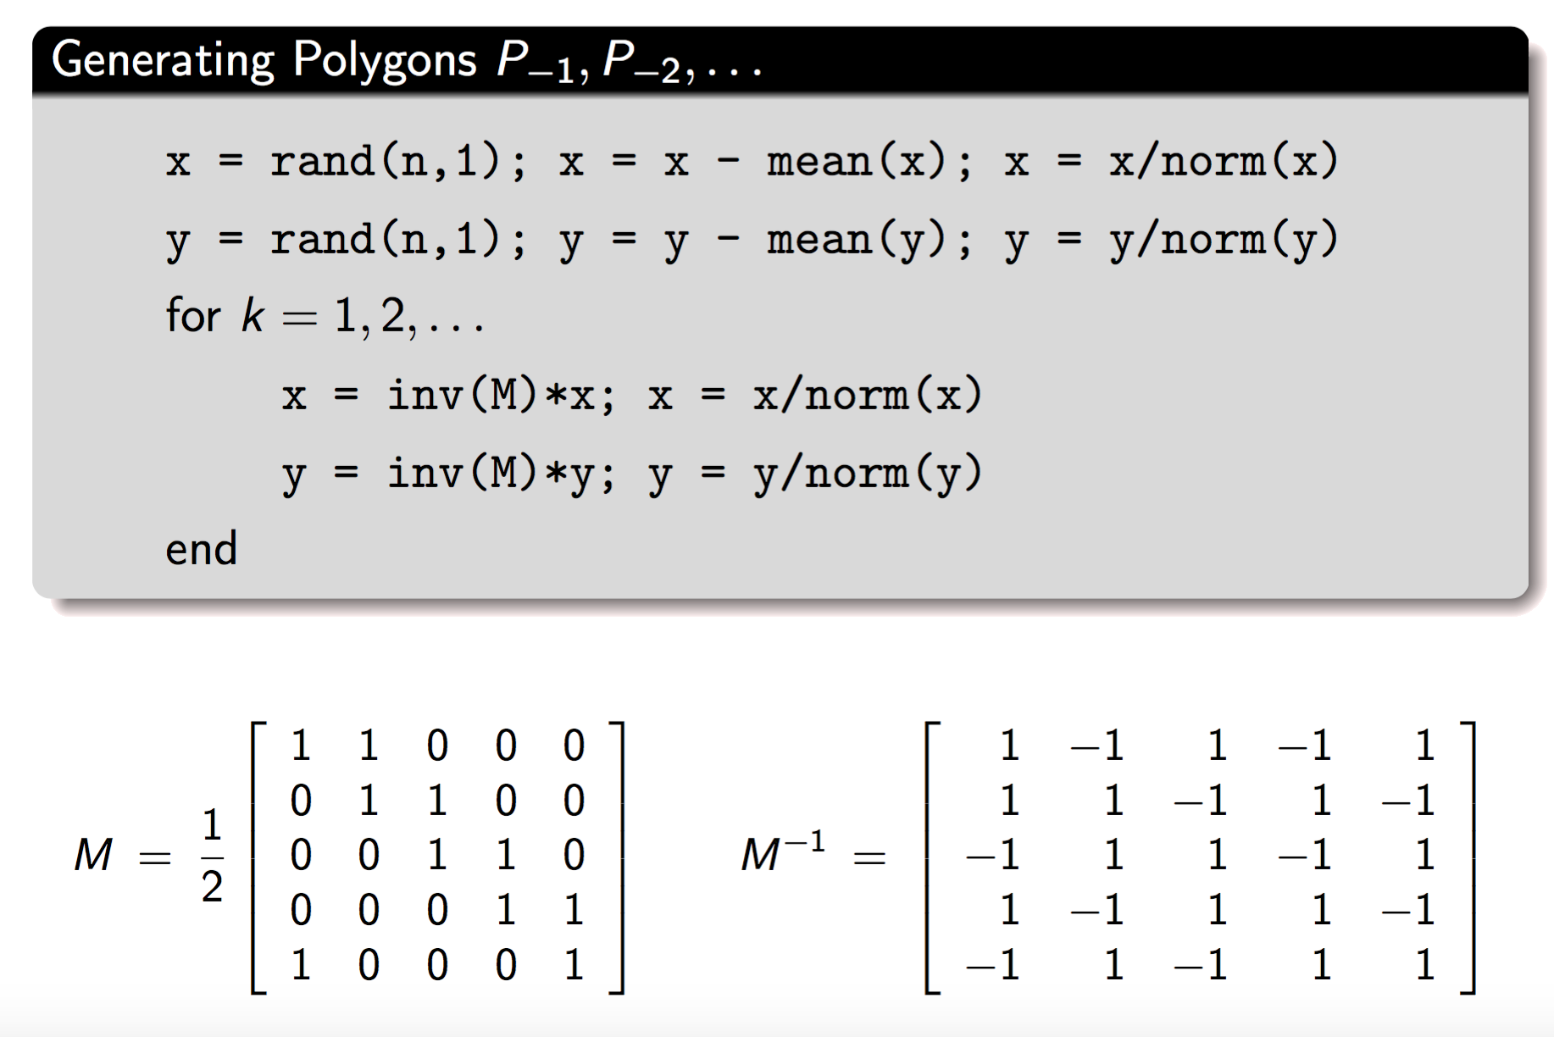
Backwards in Time?

Slide 25
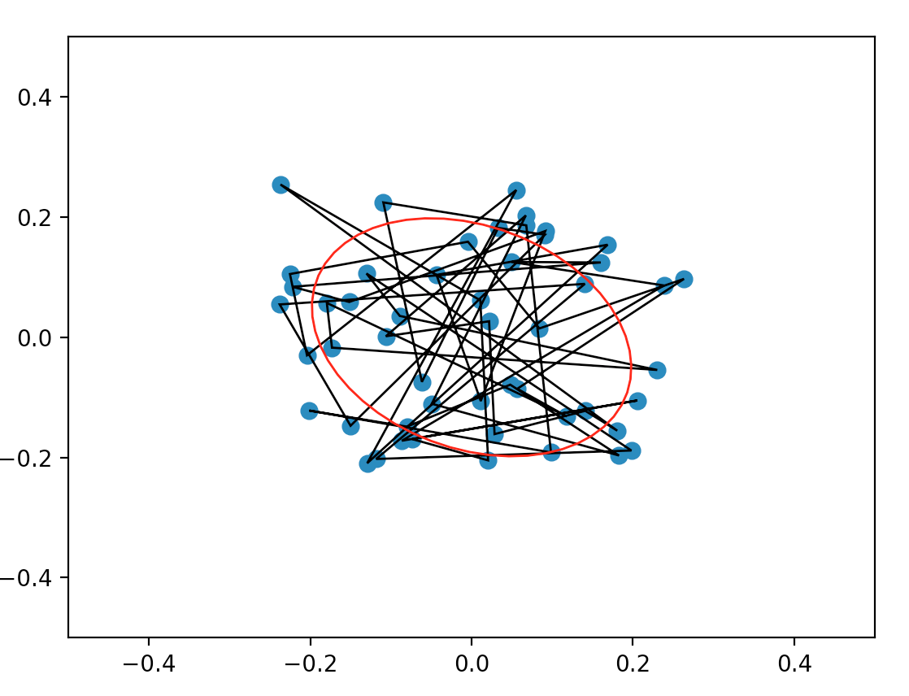
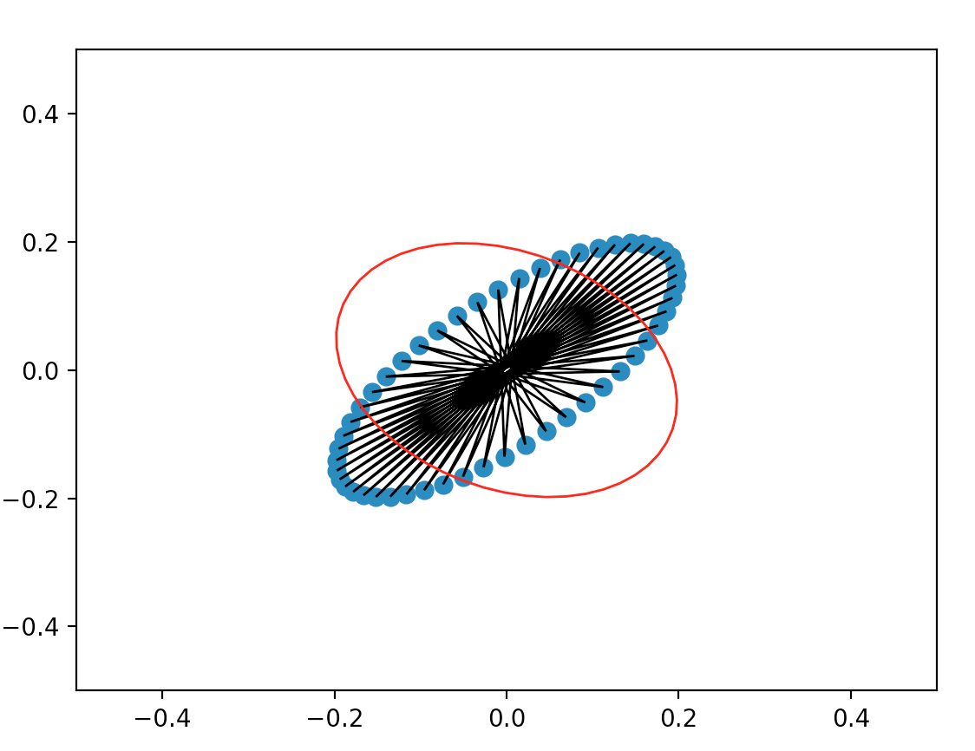
Example: n=51 points. WTH?
Does M⁻¹ always exist? No! Only for odd n. [ For intuition on the non-existence of the inverse for even n, chose 4 random points (assume time step t) and try to infer 4 points (time t-1) which lead to the 4 points at time t. After being successful, try to find another 4 points which can lead to the same 4 points. After being successful, what does this tell us about the inverse of M? ]

Slide 26
An important note of caution
We learned that the centroids do not change (by mathematical proof!) When submitting a solution to the lab exercise, please (try to) check: is this true in your simulation? If not, how to “fix” it? ( -> enforce a mean(x)=0 and mean(y) after each step? Is this a fix? No! But at least better.)
Numerical issues can be very complicated i.) to detect and ii.) to resolve!!

Slide 27
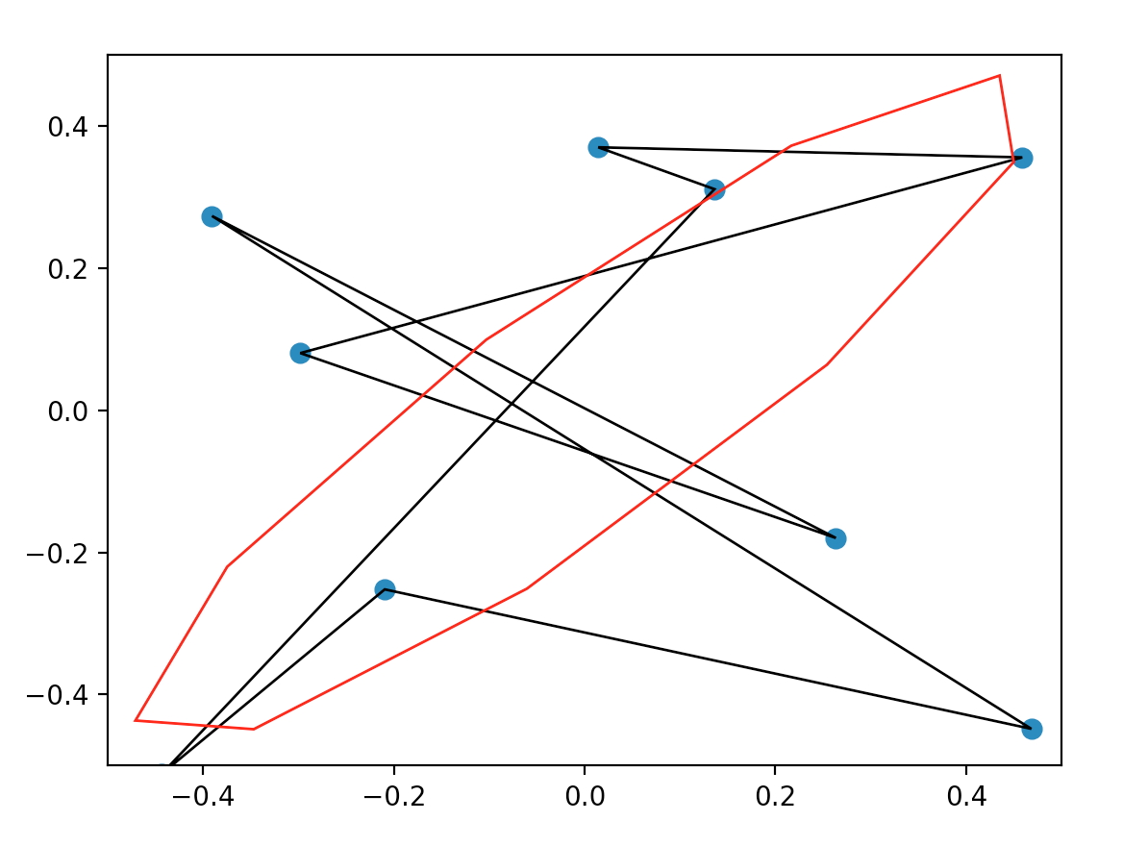
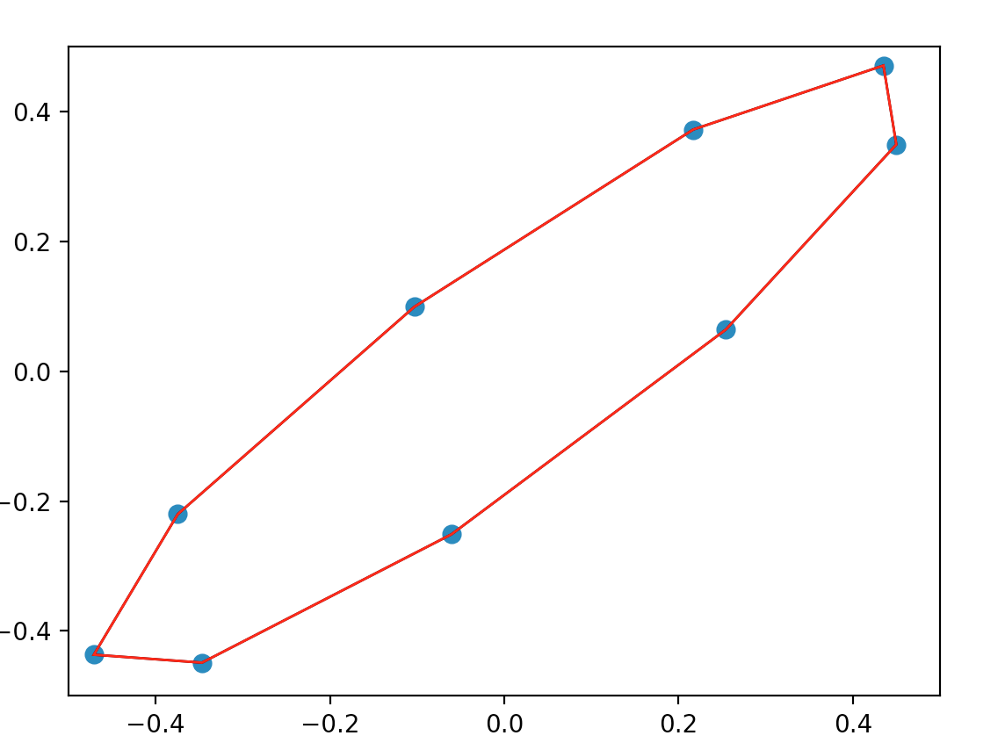
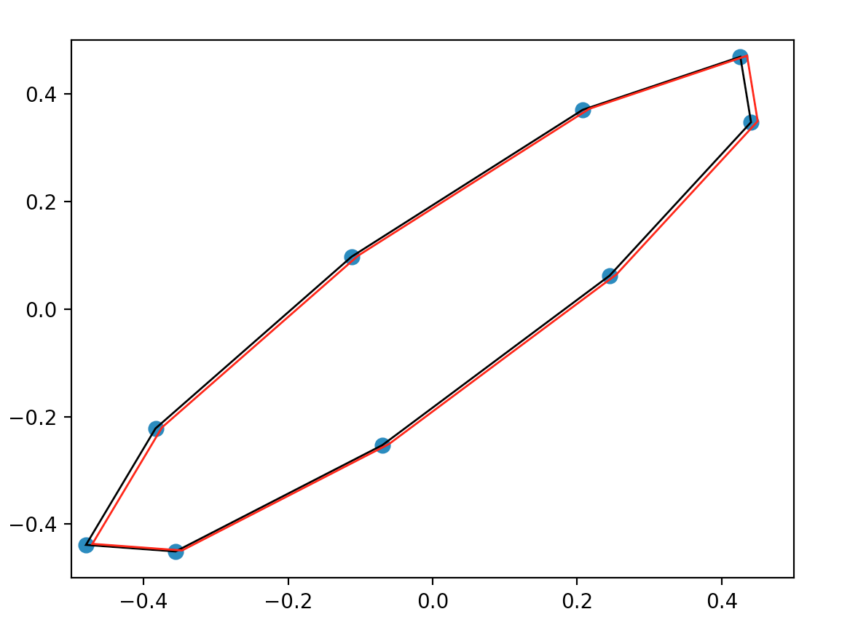
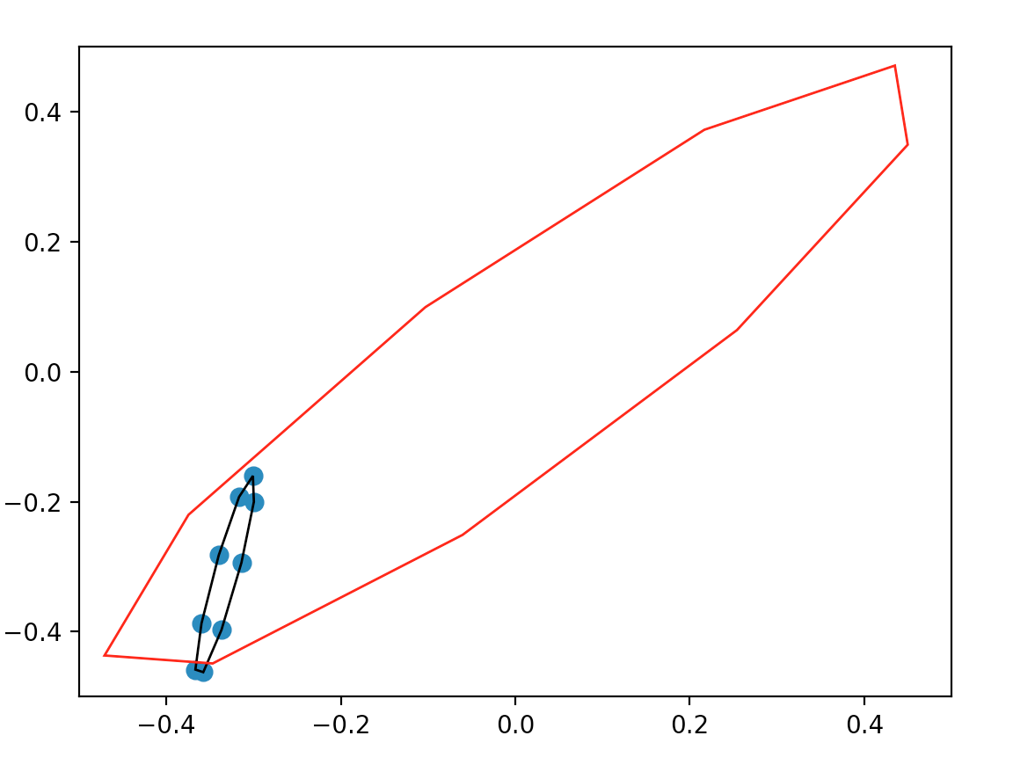
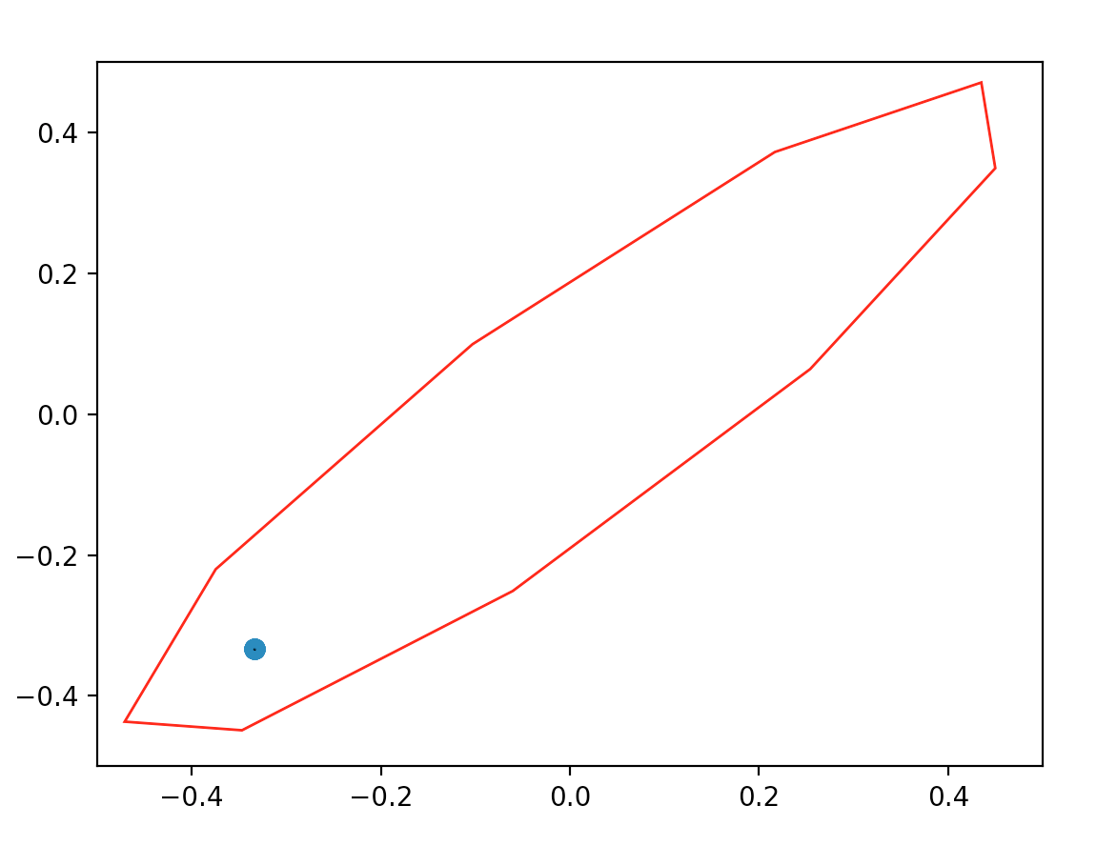
A Second Try
Iteration with 9 points at step 0, 400, 500, 600, and 700, without enforcing the mean to be 0. The simulation was done using for increased simulation speed.
Numerical Issues!

